Slide 1
Introductory Concepts
MALA 60970
Dr. Curt Rode

Slide 2
Artificiality of Academic Writing

Slide 3

Artificiality of Academic Writing
When you’re writing in school, you’re mostly writing for a captive audience.
Even the best teachers are still paid a salary to give you feedback. They have to give you feedback whether they feel like it or not.

Slide 4
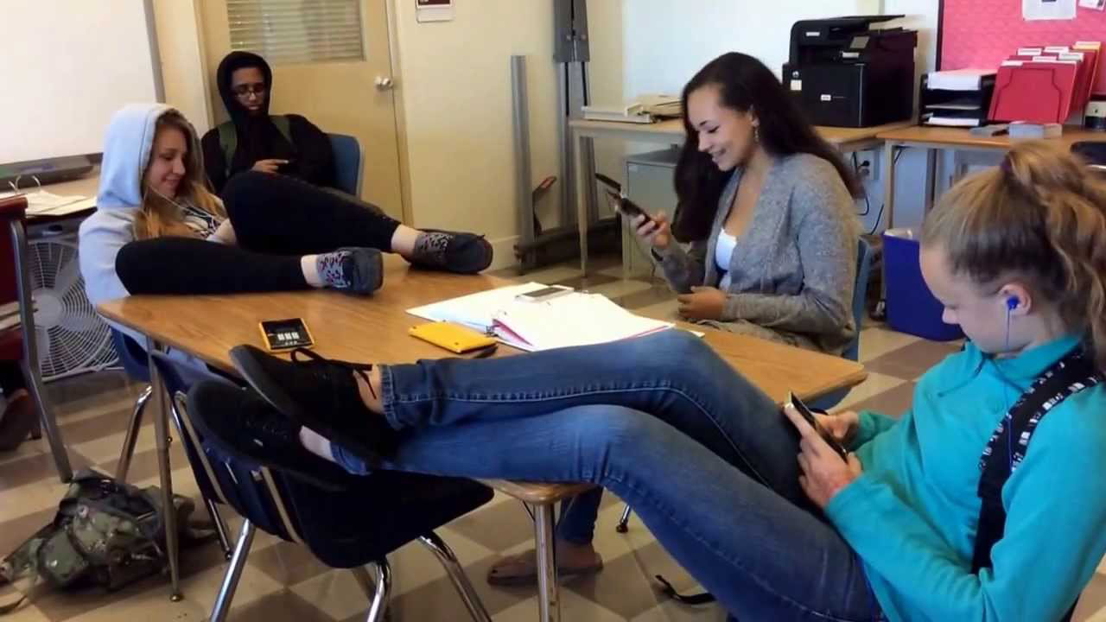
Artificiality of Academic Writing
When you’re writing in school, you’re mostly writing for a captive audience.
Even if your classmate is your best friend, they probably would rather doing something else. They’re helping you for the reward of a grade.

Slide 5
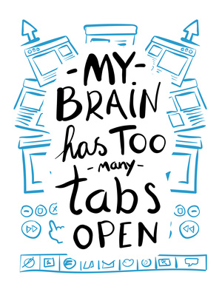
Artificiality of Academic Writing
In school, we’re rarely encouraged to write for a non-academic audience, you know, the folks we’ll need to communicate with after our formal education is behind us.

Slide 6
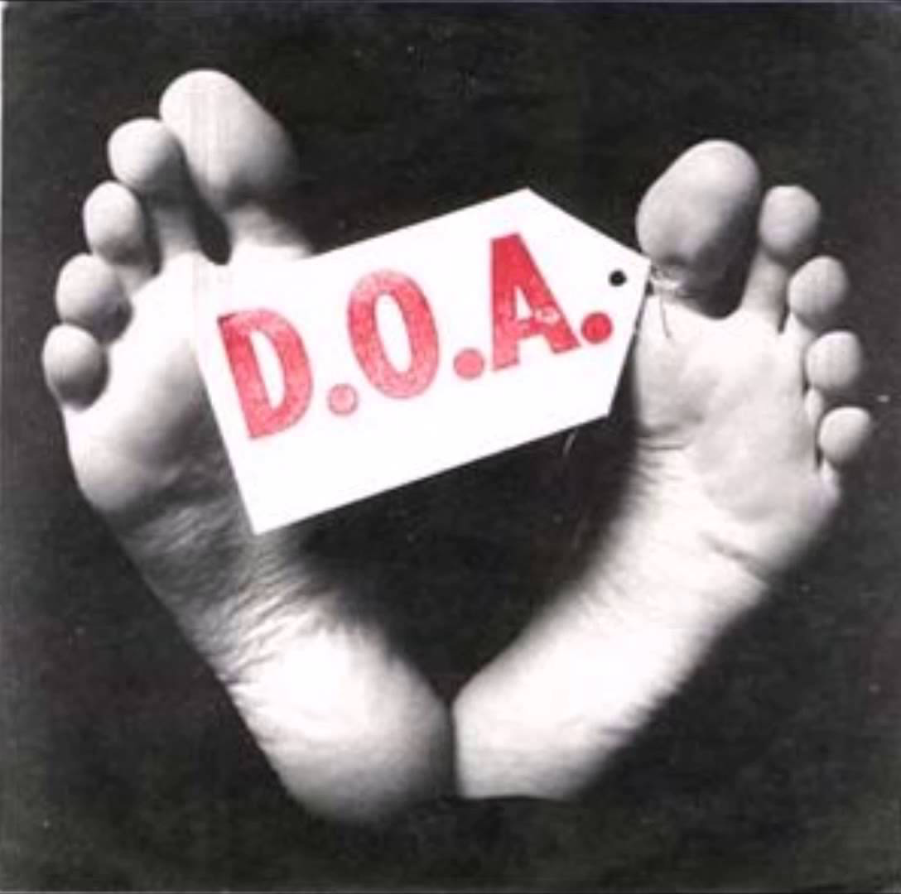
Artificiality of Academic Writing
Additionally, academic arguments are primarily intellectual exercises.
As such, they have virtually no shelf life after the after they’re graded by the instructor.

Slide 7
Artificiality of Academic Writing
To put it bluntly, when’s the last time an 8 to 10 page research paper went viral?

Slide 8
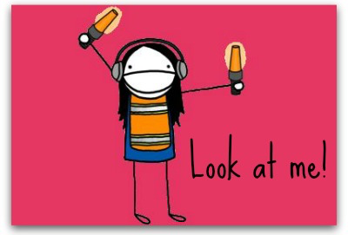
Artificiality of Academic Writing
To communicate with a non-academic audience, you have to be strategic if you want your ideas to:
have longevity
attract and sustain your audience’s attention.
In short, you have to make your ideas literally appealing.

Slide 9
Fundamentals of Argument

Slide 10
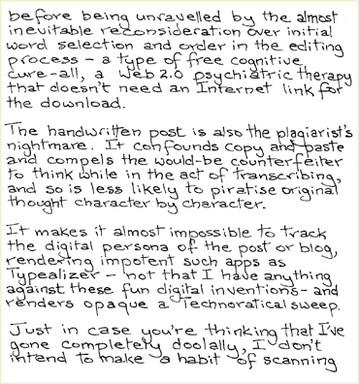
Argument: The Appeals
To be read and taken seriously, texts don’t simply need to be well-written.

Slide 11
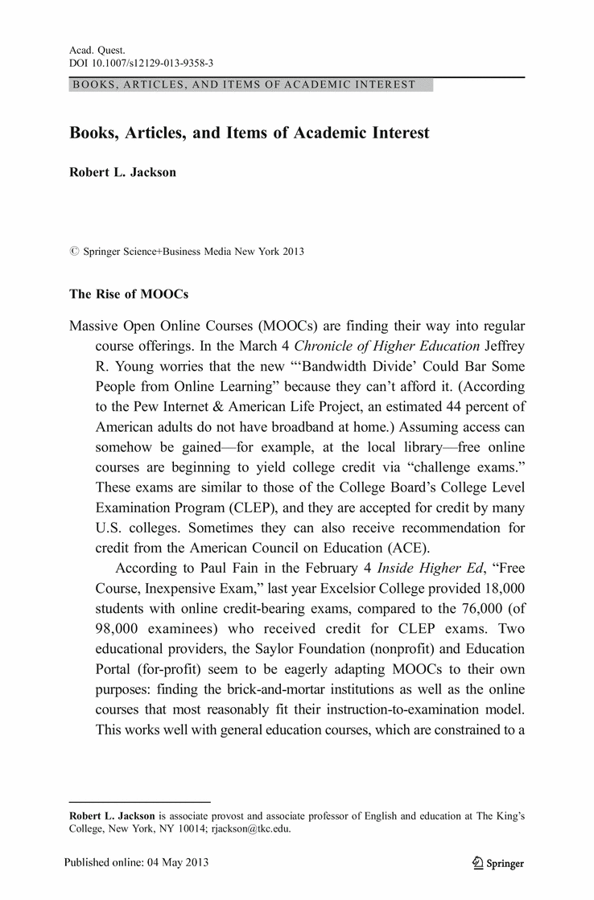
Argument: The Appeals
Texts also need to be thoughtfully designed.
Handwritten
& scanned blog post
Academic article

Slide 12
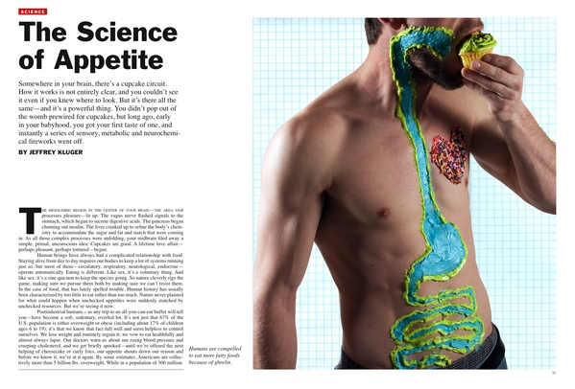
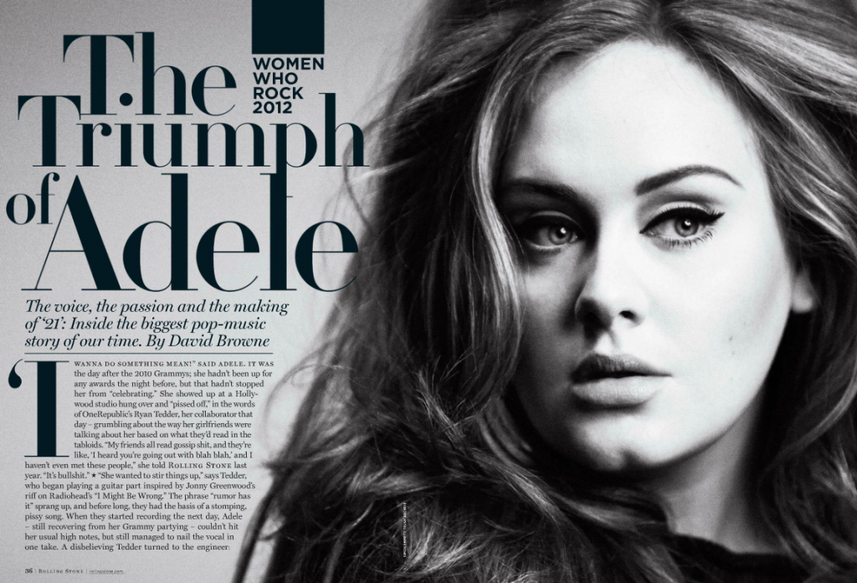
Argument: The Appeals
And the visual design depends on purpose, genre, and audience.
Article in Time
Article in Rolling Stone

Slide 13
Argument: The Appeals
Aristotle’s Rhetorical Triangle:
Logos
Thankfully, we don’t need to start from scratch in terms of how we analyze and compose new media (multimodal) compositions.
Classical rhetoric can still help us develop effective writing and design strategies.
Pathos
Ethos

Slide 14
Argument: The Appeals
Aristotle’s Rhetorical Triangle:
In your notes,
Write down a clear definition of each term.
Then, take a few minutes to explore why we need three distinct appeals. Why can’t we get by with one or two?
Logos
Pathos
Ethos

Slide 15
Argument: The Appeals
Aristotle’s Rhetorical Triangle:
Logos
Possible explanations:
Human beings are complicated creatures whose emotional, intellectual, and ethical needs are always in flux (and if that’s true for individuals, it’s certainly true for groups of individuals).
Pathos
Ethos

Slide 16
Argument: The Appeals
Aristotle’s Rhetorical Triangle:
Logos
Why Compose Multimodally?
Human beings receive information through each of the five senses.
New media compositions seek to appeal to their audience by seeming to engage a greater number of the physical senses.
Pathos
Ethos

Slide 17
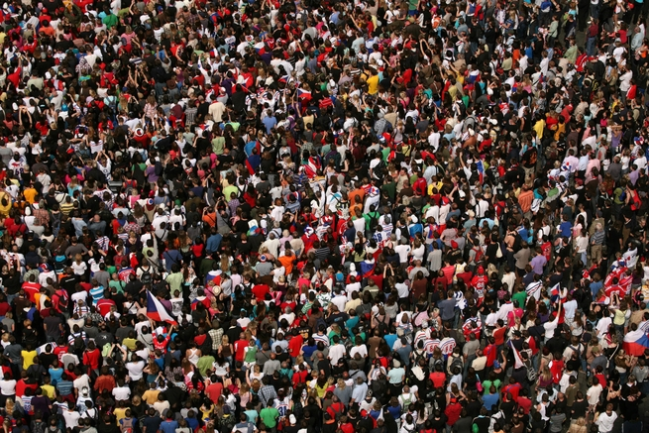
Who Are They?
Argument: Audience
Really, it all comes down to expanding our understanding of Audience.
For our purposes, Audience can be defined as “people who don’t know you and who don’t initially have the time for and/or interest in what you have to say.”
How do we get past that initial resistance?
How can we make our ideas appealing in multiple ways?

Slide 18
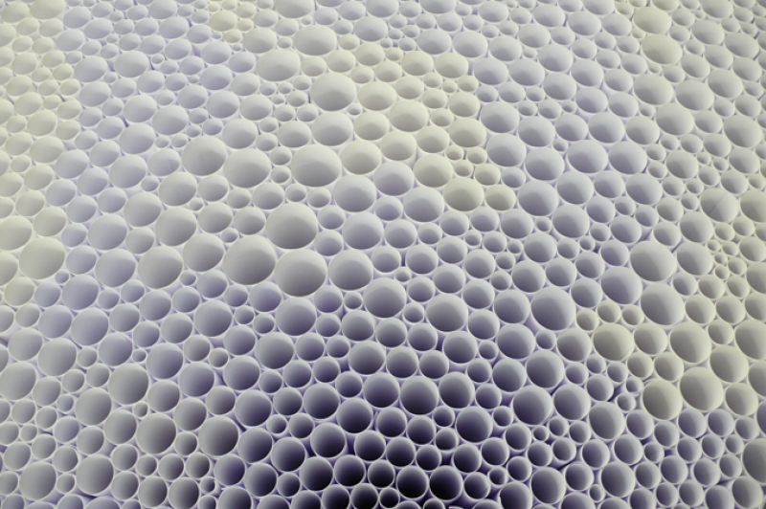
The Materiality of Writing

Slide 19
Materiality
ma·te·ri·al·i·ty n. pl. ma·te·ri·al·i·ties
The state or quality of being material.
Physical substance; matter.

Slide 20
Materiality
Words have never been mere information.
Words are always understood (initially) through the physical senses.
Hence, all verbal compositions can be thought of as
physical objects
that have a material reality
as well as intellectual or emotional content.
Don’t believe me? Consider the following…

Slide 21
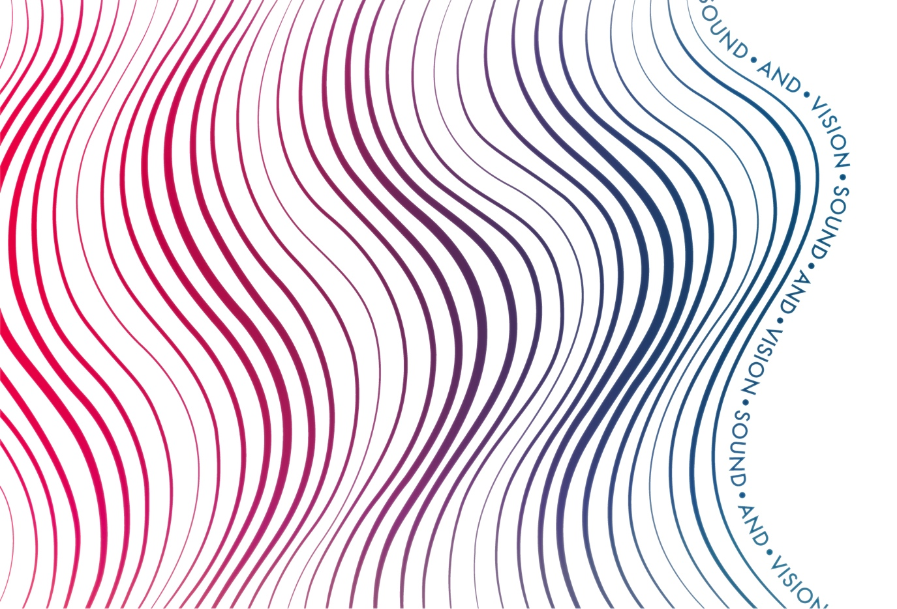
Materiality (Acoustic)
In Oral Cultures, words were first
combinations of sounds
that then carried
culturally-defined packets
of information.

Slide 22
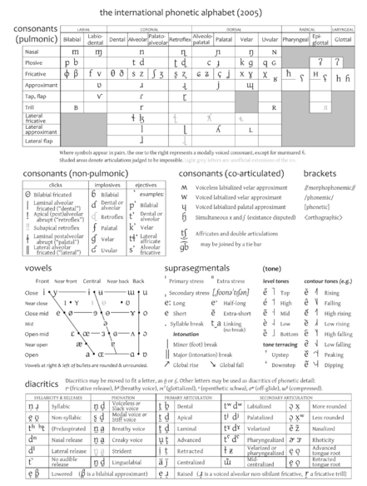
Materiality (Acoustic)
In the most literal sense:
Hearing
precedes
listening.

Slide 23

Materiality (Visual)
With the advent of writing systems, words became
combinations of abstract visual shapes
that then provided
visual notation for sounds
+
culturally-defined packets
of information

Slide 24
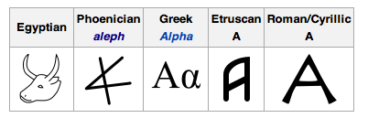
Materiality (Visual)
In the most literal sense:
Seeing
precedes
reading.

Slide 25
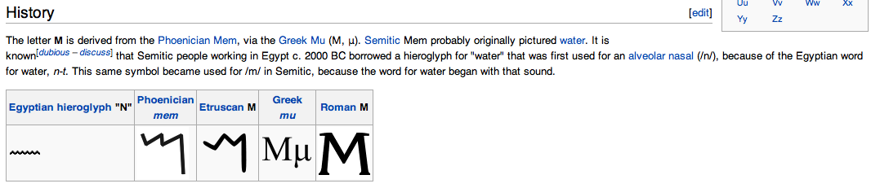
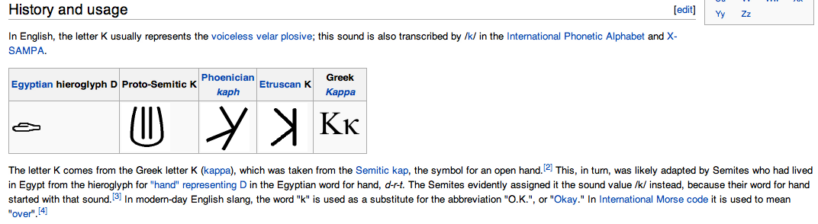
Materiality (Visual)
To wit:

Slide 26
Materiality (Visual)
Redefinitions:
Listening is hearing with the intention to discern meaningful or usable patterns within a field of auditory data.
Reading is seeing with the intention to discern meaningful or usable patterns within a field of visual data.

Slide 27
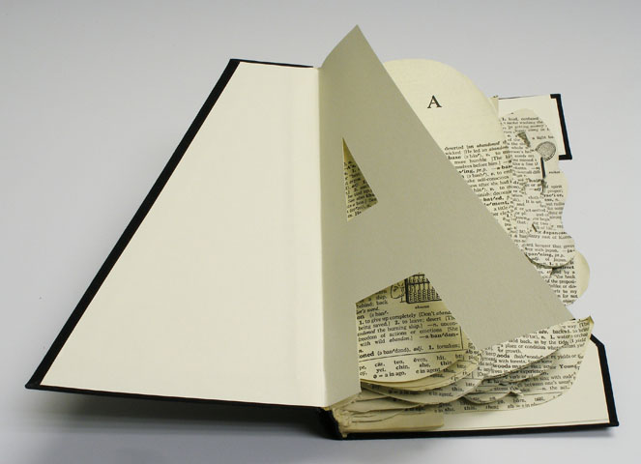
Form = Content

Slide 28
Form = Content
For our purposes, “Form = Content” means:
The way a word is materially delivered becomes part of the word’s connotative meaning. The material delivery also factors into logos, pathos, and ethos.
Additionally,
If you change a material characteristic of a verbal composition, you alter part of the connotative meaning of that composition.

Slide 29
Form = Content
To wit (by adding or subtracting pixels and adjusting color value):
You are the best student ever.
You are the “best” student ever.
You. Are. The. Best. Student. EVER.
#yerdabeststudentever

Slide 30
Form = Content
To wit:
so much depends upon a red wheelbarrow glazed in rainwater beside the white chickens

Slide 31
Form = Content
To wit (by playing with lineation):
so much depends
upon
a red wheel
barrow
glazed in rain
water
beside the white
chickens
The Red Wheelbarrow (1923)
William Carlos Williams

Slide 32
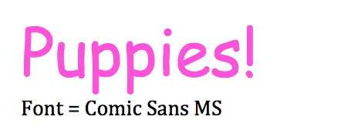
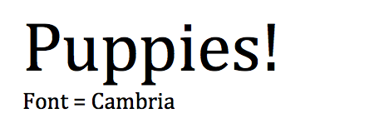
Form = Content
To wit (by playing with font type and color):

Slide 33
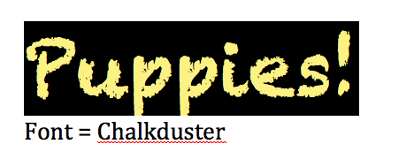
Form = Content
To wit:

Slide 34
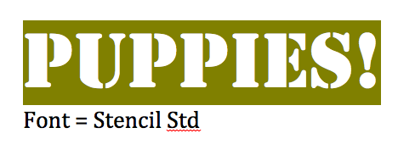
Form = Content
To wit:

Slide 35

Form = Content
To wit:

Slide 36

Form = Content
To wit:

Slide 37

Form = Content
To wit:

Slide 38
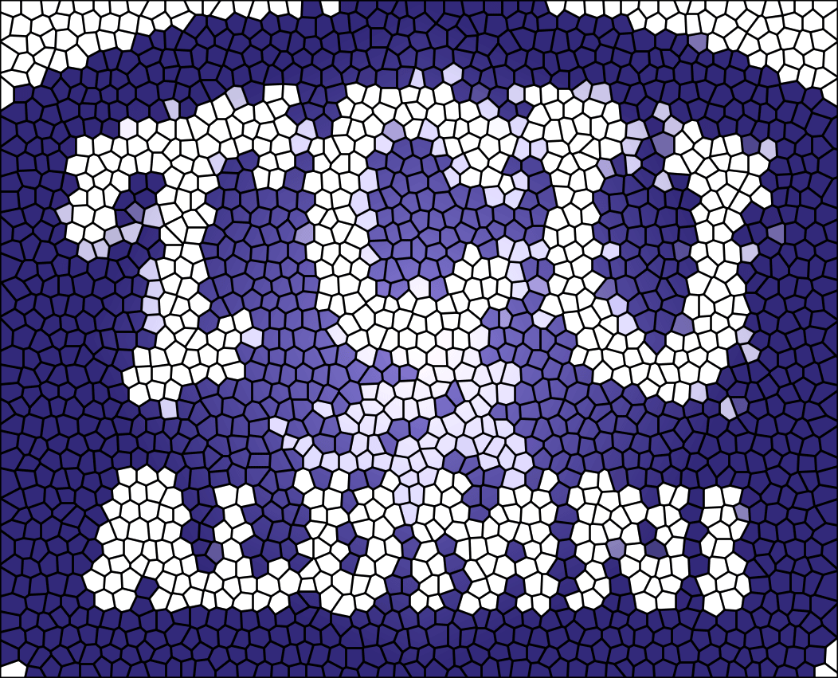
Form = Content
To wit:

